Slide 1
Learning platforms VoC
WORK IN PROGRESS
May 2021

Slide 2
Background
CTF
I wonder if we might want to stress:
The high number of listening posts we have currently, inc over-exposure of Sentiment data
The disintegrated nature of VoC data/feedback today
The lift that that creates for the team to monitor, analyse and act on the signals we receive from these LP
The limits they place on our ability to scale the VoC programme
The need to consolidate the LP, and exploit the Frequent, regular, automated, low intensity LP to act as ‘canaries in the mine’ that will trigger the Infrequent, irregular, manual, high intensity LP when certain metrics are breached.
VK 25.May.21:
Background
Current listening posts and how we define them
Observations around what we do differently, what that means
Scale diagram (current slide 5)
Implications - what we will and will not listen to
Shift to Agile product management provides opportunity to review how we obtain and utilize user feedback to drive product improvements
Current state involves several listening posts with distributed ownership/management
Opportunity to consolidate our feedback collection efforts to ensure we efficiently get the input we need via a predictable, proactive approach and are able to use it effectively to prioritize and deliver improvements most important to learners
VK 18.May.21:
The opportunity we see, VoC next evolution
Centralize listening posts that connect the voice of the customer through recurring and standardized inputs
Use data to diagnose learner needs and prioritize experience improvements for continuous improvement
Structure user input channels in line with
Clarity on how/who/where data is being used
Feedback loop to users?
Measure impact of data-driven improvements
VK 20.May.21: Anything about closing the loop?

Slide 3
Current state indexed toward sentiment/lagging feedback
VK 20.May.21: definitions for these categories
What goes and what says as-is
VK 22.May.21: Alternate view
Sentiment
Friction/failure
Predictive
Perf.
EIP survey (awareness)
People Survey
IT Pulse Survey
LAB NPS
ODT surveys
Live training surveys
Web 2.0
MERGE
Behavioral data
Support desk
Focus groups
LEMA

Slide 4
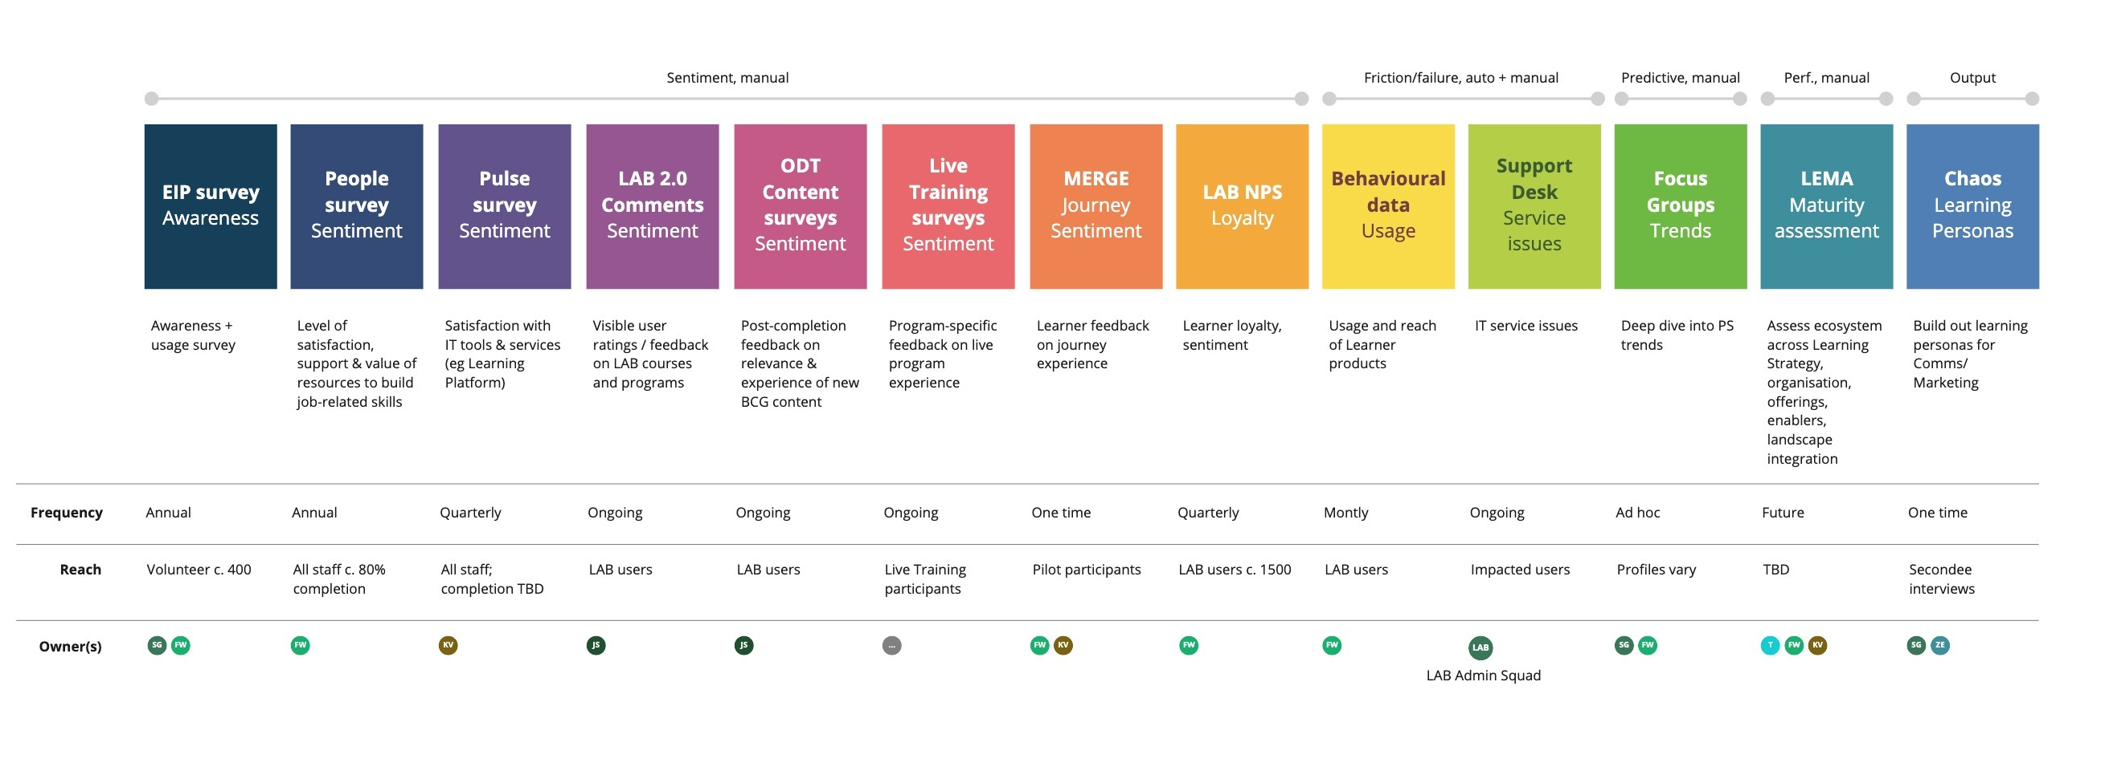
Current state indexed toward sentiment/lagging feedback
VK 20.May.21: Placeholder from Chris' slides
WF 02.Jun.21: Product Awareness Survey: assesses learner awareness and usage of key product areas
People Survey: annual global employee feedback survey, includes 5 questions for employee satisfaction with learning offering
Pulse Survey: satisfaction with learning content for IT tools and services
LAB 2.0 Comments: UI-visible 5-star ratings from users for LAB courses and programs
ODT Content Surveys: post-completion content-focused feedback surveys for on-demand LAB courses
Live Training Surveys: post-attendance content-focused feedback for live (virtual, in-person) courses
MERGE Journey: learner feedback on journey platform experience
LAB NPS: users rate likelihood of recommending platform to a colleague (loyalty)
Behavioral Data: quantitative data for site and content usage
Support Desk: user-reported service deck issues
Focus Group: user interviews for gathering feedback on key priority areas (shifting focus)
LEMA Questionnaire: externally applied assessment of learning ecosystem across 5 domains and 18 dimensions

Slide 5
Analysis of current state and what we need/want to change
VK 25.May.21: Lessons learned
What we should do differently (ie scalability)/what doesn't work/current pain points
As a result, recommendations are XYZ
We will intentionally focus our analysis effort for platform improvements to a narrower set of existing listening posts
While these channels will continue to run, would not be prioritized for platform specifically:
IT Pulse Survey
ODT surveys
Live training surveys
Web 2.0 feedback
Support desk
Addition of quarterly focus groups will allow us to pursue deeper insight on survey trends/themes
We will be able to proactively investigate hypotheses around latent needs

Slide 6
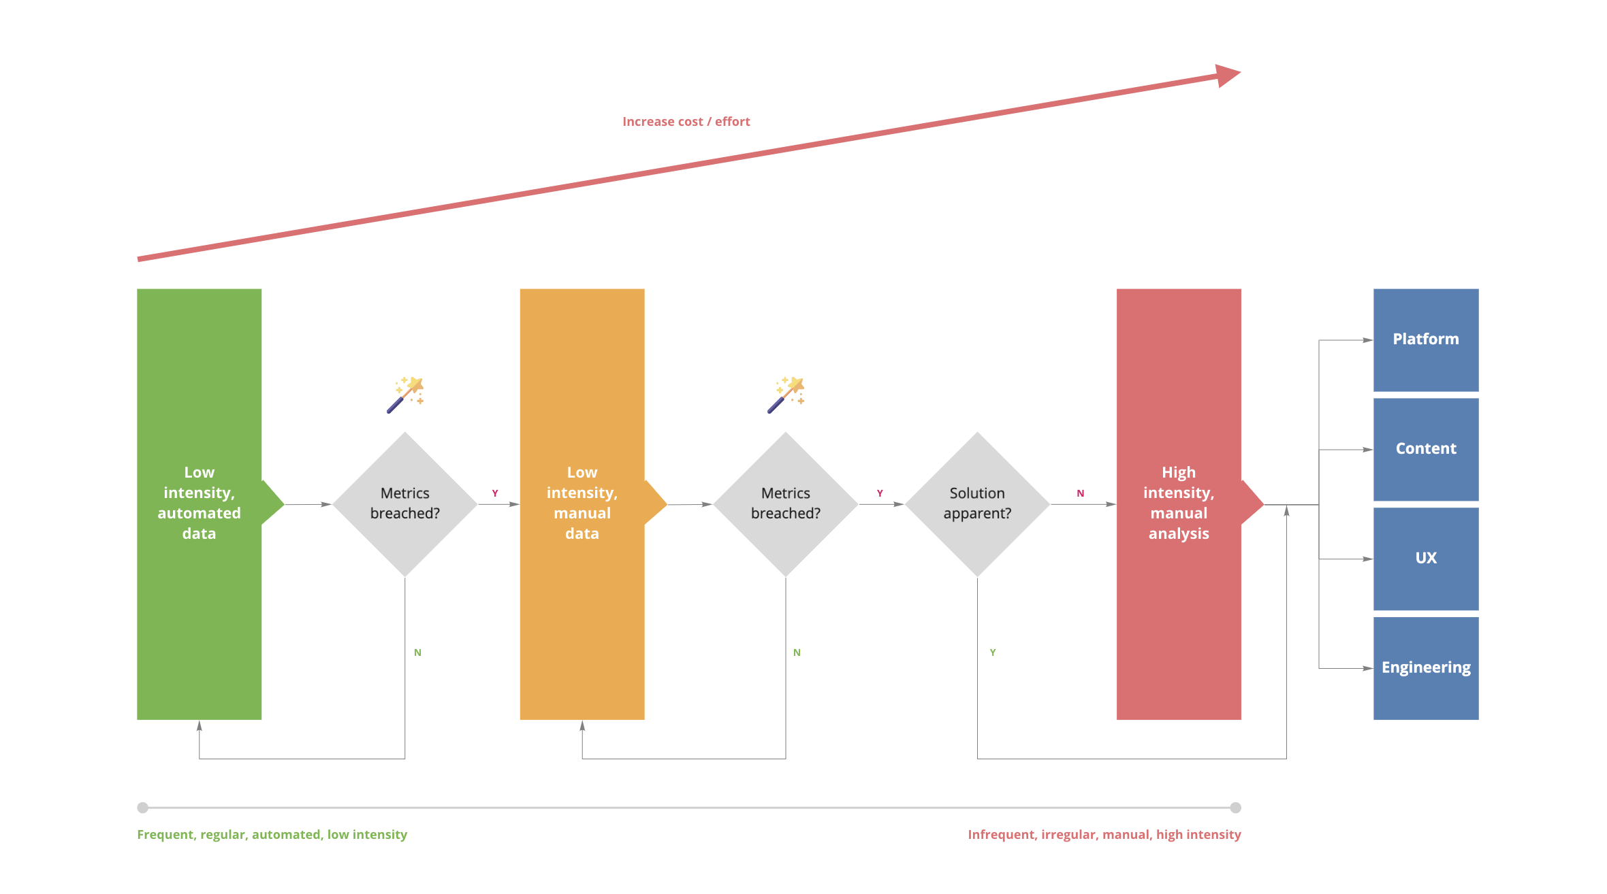
Adding regular feedback panels to augment insights and better surface latent needs
VK 25.May.21: list the activities under each ill.
CTF
This is great – I wonder if we want to update the flow (pasted in here) to reflect these new LP, alongside the green Pillar
VK 18.May.21: we index high on sat/sentiment and need to fill gap – more insight to leading indicators, latent needs
This slide is about adding new listening post
Quarterly user interviews
Deep dive on feedback themes or exploring other questions we have
CTF
Do we want to include this (or a revision of this)?

Slide 7
Future portfolio mix of predictable, low- and high-effort listening posts
VK 25.May.21: Placeholder: Learner posts future state
VK 25.May.21: Break out per audience – gaps per each
Emphasis to add more leading
Purpose
# | Channel | Freq | Direction | Description | Satisfaction | Value | Awareness | Behavior
1 | People Survey | Annual | Lagging | Internal BCG employee value proposition survey for key learning domains Est/Target sample size: 15k | ✓ | ✓
2 | LEMA Questionnaire¹ | Annual | Lagging | Assess learning ecosystem across 5 domains and 18 dimensions, external benchmarks Est/Target sample size: | ✓ | ✓
3 | Awareness Survey | Annual | Lagging | Assess awareness and usage of key product areas Est/Target sample size: 500 |  |  | ✓ | ✓
4 | Net Promoter Score | Monthly | Lagging | Just in time survey for users to rate likelihood of recommending platform Est/Target sample size: 200/month | ✓
5 | Focus Groups | Quarterly | Leading/ Lagging | User interviews to gather user feedback on key priority areas (shifting focus) Est/Target sample size: 5-15 | ✓ | ✓ | ✓ | ✓
6 | Feature surveys (e.g. search) | Quarterly | Leading/ Lagging | Just in time survey for key/new features to assess user satisfaction Est/Target sample size: | ✓
7 | Site behavior | Monthly | Leading | Quantitative data for site usage Est/Target sample size: all users |  |  |  | ✓
1. Not yet implemented

Slide 8
Future portfolio mix of predictable, low- and high-effort listening posts
VK 25.May.21: Placeholder: LL&D/PTO posts future state
VK 25.May.21: Emphasis to add more leading
Purpose
# | Channel | Freq | Direction | Description | Satisfaction | Value | Awareness | Behavior
1 | People Survey | Annual | Lagging | Internal BCG employee value proposition survey for key learning domains | ✓ | ✓
2 | LEMA Questionnaire¹ | Annual | Lagging | Assess learning ecosystem across 5 domains and 18 dimensions, external benchmarks | ✓ | ✓
3 | Awareness Survey | Annual | Lagging | Assess awareness and usage of key product areas |  |  | ✓ | ✓
4 | Net Promoter Score | Monthly | Lagging | Just in time survey for users to rate likelihood of recommending platform | ✓
5 | Focus Groups | Quarterly | Leading/Lagging | User interviews to gather user feedback on key priority areas (shifting focus) | ✓ | ✓ | ✓ | ✓
6 | Feature surveys (e.g. search) | Quarterly | Leading/Lagging | Just in time survey for key/new features to assess user satisfaction | ✓
7 | Site behavior | Monthly | Leading | Quantitative data for site usage |  |  |  | ✓
1. Not yet implemented

Slide 9
Parking lot
GS 22.Apr.21: How are we consolidating and storing? should have one place for transparency
How is each color/team gathering feedback?
- Limiting siloed efforts (i.e., curation interviews, etc)
VK 04.May.21: Satisfaction
NPS
People Survey
IT Pulse?
LAB 2.0
Content surveys
Awareness
EIP
Focus groups
Value
EIP
People Survey
Lab 2.0
Content surveys
Behavior
EIP
Behavioral data
Focus groups
Coverage

Slide 10
Backup

Slide 11
Several existing listening posts address multiple aspects of learning experience
Channel | Purpose | Audience | Frequency | Addresses
Employee Input Panel | Awareness/Usage Survey | Volunteer (~400) | Annual | Content, tools
People Survey | Level of satisfaction, support and value of resources to build job-related skills | All staff (~80% completion) | Annual | Content, tools
LAB NPS | Learner loyalty/sentiment | LAB users (1,500) | Quarterly | Content, tools
IT Pulse Survey | Satisfaction with IT tools and services (i.e Learning Platform) | All staff (TBD rate) | Quarterly | Jean
Behavioral data | Usage and Reach of Learning Products | LAB users | Monthly | Freddie
Support desk | IT service issues | Impacted users | Ongoing | LAB Admin Squad
LAB 2.0 comments | Visible user ratings/ feedback on LAB courses and programs | LAB users | Ongoing | Justin
Content surveys (ODT) | Post-completion feedback on relevance and experience of new BCG content (first 90 days) | LAB users | Ongoing | Justin
Live training surveys | Program specific feedback on live program experience | Live training participants | Ongoing | Various
Focus groups | Deep dive into PS trends | Profiles vary | Ad hoc | Sarah/ Freddie
MERGE | Learner feedback on journey experience | Pilot participants | One time | Kate/Freddie
Chaos | Build out learning personas for comms/marketing | Secondee interviews | One time | Sarah/Zoe
LEMA | Learning Eco-system Maturity Assessment- assesses eco-system across 5 domains: learning strategy, organization, offerings, enablers, landscape integration | TBD | Future | Tom/Kate/Freddie

Slide 12
Current question set: IT Pulse Survey
Overall, how satisfied are you with the learning that IT provides for the tools you use? (Radio button, single choice: Very satisfied, Satisfied, Neutral, Dissatisfied, Very dissatisfied, + comments box)
How satisfied are you with the following learning related aspects for IT tools?
The LAB platform [Radio button, single choice: Very satisfied, Satisfied, Neutral, Dissatisfied, Very dissatisfied, + comments box]
How virtual learning is delivered outside LAB (e.g. virtual, in-person)
Learning topics available
How easy it is to find IT learning resources
What IT tools do you most need training on? (open text)
Overall, how satisfied are you with the communications received from IT? [Radio button, single choice: Very satisfied, Satisfied, Neutral, Dissatisfied, Very dissatisfied, + comments box]
How satisfied are you with the following specific kinds of communications received from IT?
Updates on IT Tools and Services [Radio button, single choice: Very satisfied, Satisfied, Neutral, Dissatisfied, Very dissatisfied, + comments box]
Updates from IT Leadership
Outage information from the IT Service Center
Communications from your Local IT team

Slide 13
Current question set: People Survey
Overall, I am satisfied with the training offerings BCG makes available to me
I feel supported to fully participate in relevant training opportunities
Did you attend a live (in-person/virtual) training experience in the past year?
The live (in-person/virtual) training experiences I have had in the past year were an important part of building my job-related skills
The live (in-person/virtual) training experiences I have had in the past year were an important part of building my affiliation with BCG
Online learning resources have helped me develop the skills I need to be successful at my work

Slide 14
Current question set: On-demand module survey
How do you rate your overall experience? (Excellent, good, average, below average, poor)
This content was relevant to my learning needs (Agree, disagree, optional comment)
What did you like best? (short answer)
What would you like to see improved? (short answer)
What other related topics would you like to learn about? (short answer)

